Slide 1
Brian Ronayne Case Study PepsiCo
20 May 2024
All code/files can be found in following GitHub repository
https://github.com/brianronayne/PepsiCo-Case-Study

Slide 2
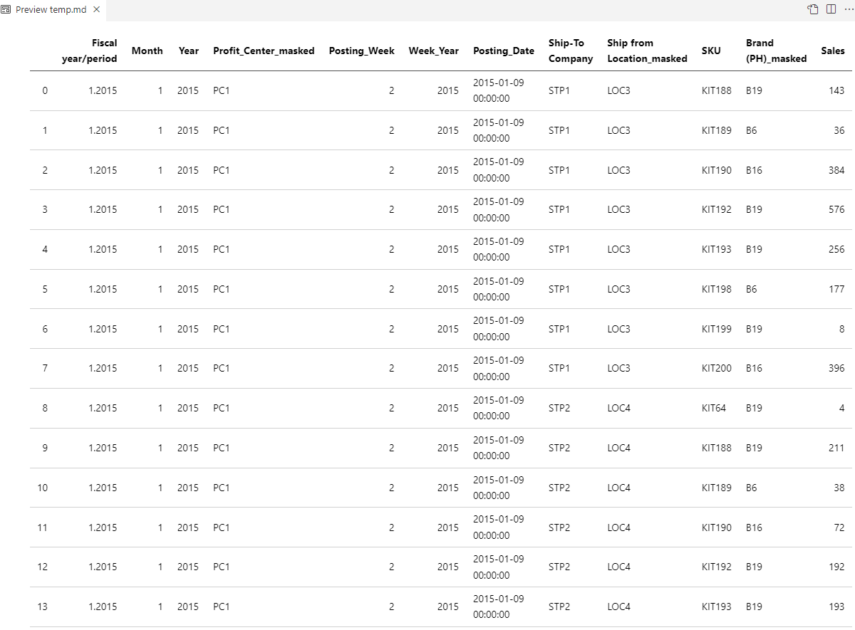
Exploratory Data Analysis
Sales variable contains negatives (approx. 0.4% of values). Assume these are due to recalls etc.
No missing values in the dataset.
Categorical variables: Profit_Center_masked, Ship-To_Company, Ship from Location_masked, SKU and Brand (PH)_masked
Numerical variables: Sales and date/time variables

Slide 3
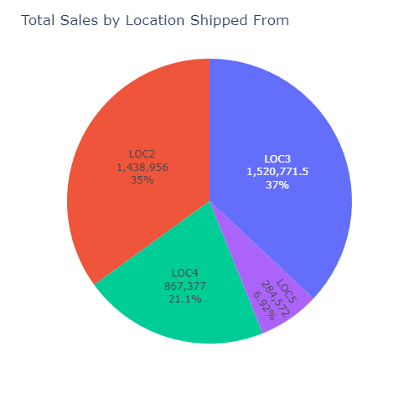
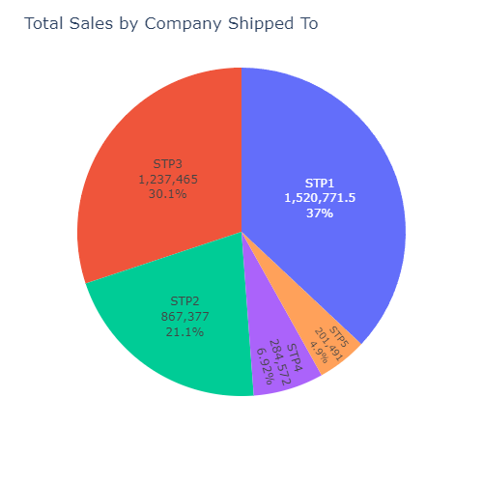
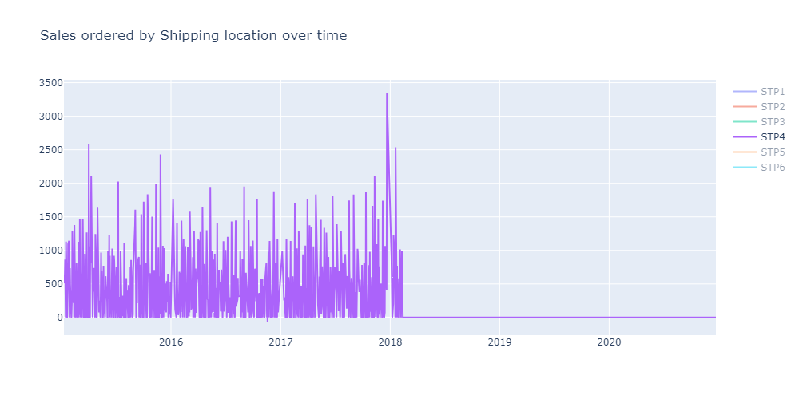
Shipping Locations & Companies Shipped to
Over 93% of sales were sent from LOC2, LOC3 or LOC4, while over 88% of sales were sent to locations STP1, STP2 or STP3
LOC3 ships solely to STP1, LOC4 ships solely to STP4 and LOC5 ships solely to STP4
Shipping to STP4 and shipping to LOC5 abruptly stops around start of 2018.
Statistically significant difference in mean sales between Locations shipped to and Locations shipped from (appendix 2)

Slide 4
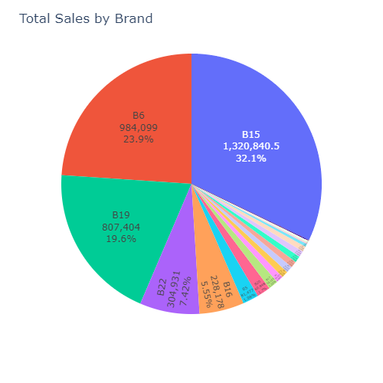
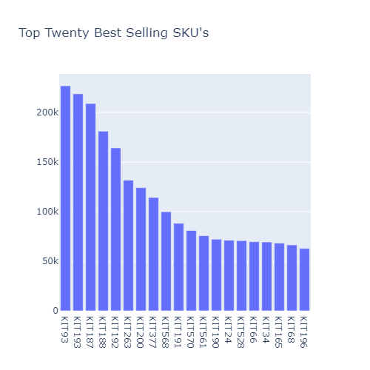
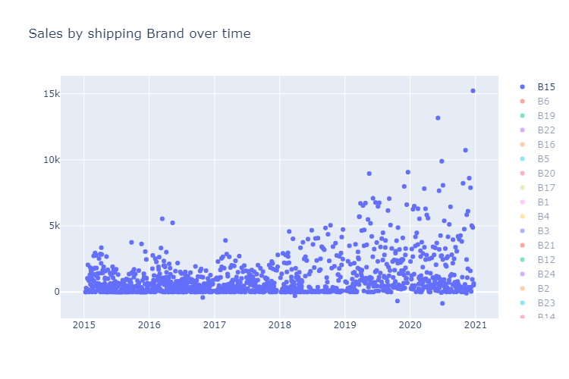
Brands & SKU’s
Brand B15, B6, B19 and B22 made up over 80% of all sales
Top 5 best selling SKU’s were KIT93, KIT193, KIT187, KIT 188 and KIT192. Two of these belonged to B6, while three belonged to B9
B15 notably grew overtime, which contributed to overall sales growth trend
Statistically significant difference in mean sales across brands and SKU’s (appendix 2)

Slide 5
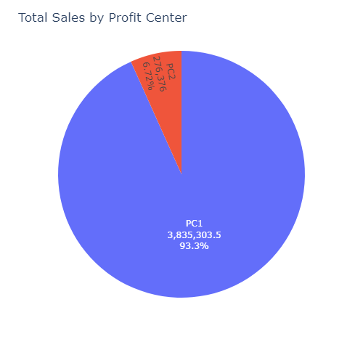
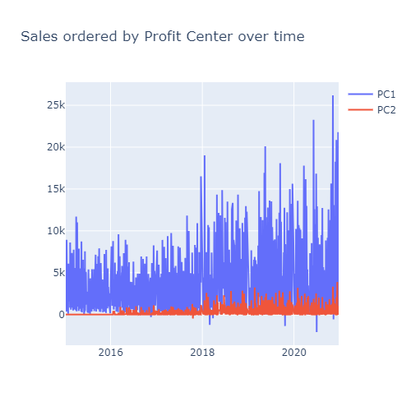
Profit Centres
Vast majority of sales come from PC1
See growth in both profit centers in 2018-2020 period. Both contribute to observed overall rise in sales
No statistically significant difference in mean sales across PC1 and PC2 (appendix 2)

Slide 6
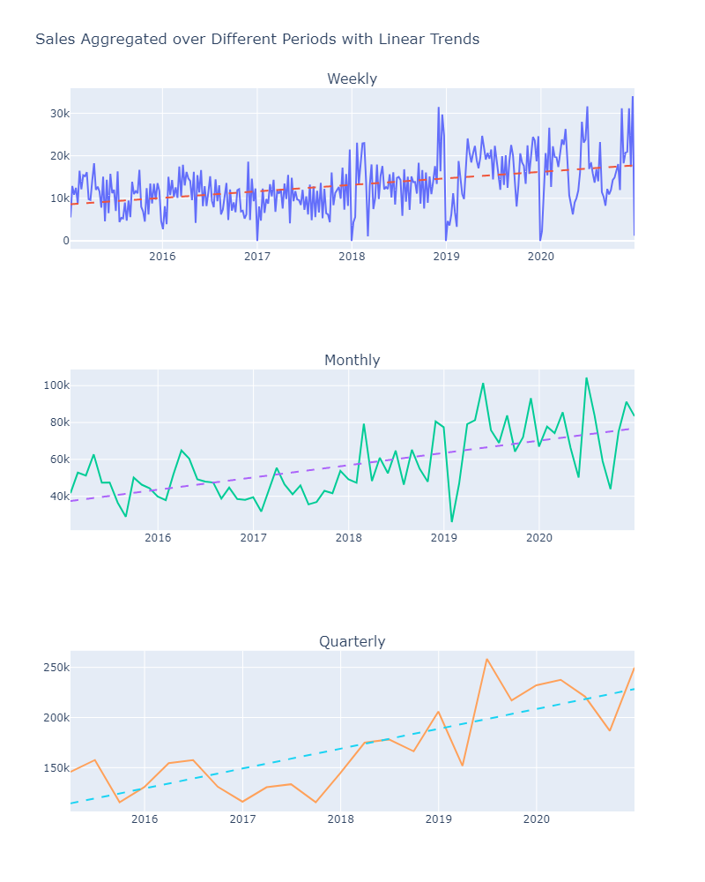
Sales
Exhibiting strong growth, particularly from 2018 onwards. Highlighted by regression lines added to plots.
Significant p-values, indicates that growth is statistically significant (See appendix 1)
Appears to be seasonality in data. There seems to be no sales made in the days leading up to the new year. Can be seen in weekly plot.

Slide 7
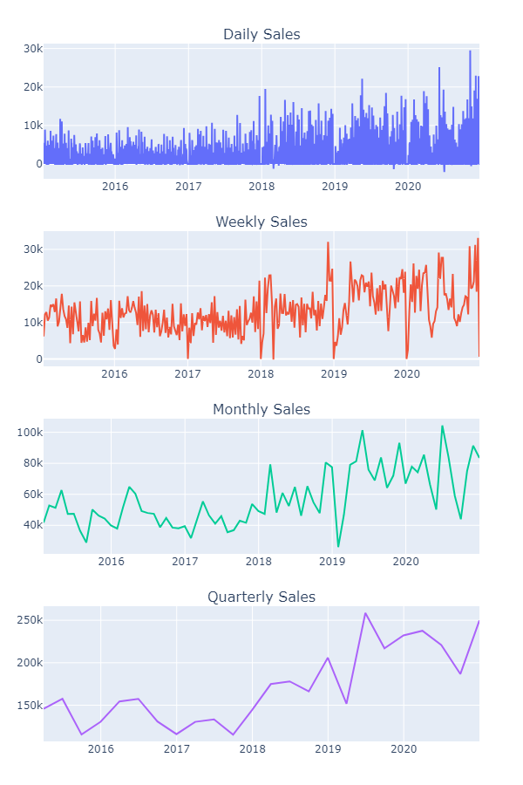
What Time Granularity to use for a Predictive Model?
Must take business considerations into account, e.g., if monthly plans used, use monthly granularity
More volatile products may benefit from lower granularity
Could develop several models for each granularity and compare performance
Weekly or monthly may be useful granularities –daily is too noisy, quarterly may smooth out features too much

Slide 8
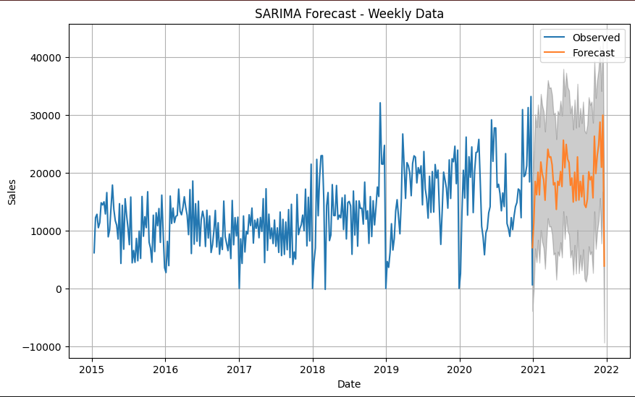
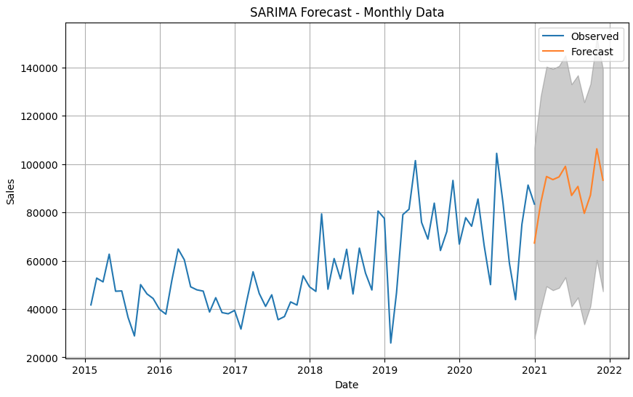
SARIMA Models
Perform trend and seasonal differencing to reduce datasets to stationarity and fit SARIMA models (see appendix 3)
Will allow us to make predictions for the following year
Weekly forecast may be more appropriate in scenarios where we wish to account for large drop in sales that occurs at year end.
Monthly forecast may be more useful for capturing overall trend

Slide 9
Machine Learning Models
ML models could incorporate information on other variables to improve predictions
Relatively small dataset and feature space may indicate that straightforward time series models may be more appropriate in this scenario
Could examine models such as Random Forest and make comparisons with time series models using RMSE, MAE or other metrics used for sales data
Time series will be more straightforward and easily explainable, ML will require more work to understand data and generate model

Slide 10
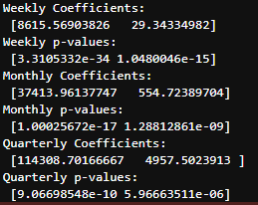
Appendix 1: Sales increasing over time
Null hypothesis: β = 0. Alternative Hypothesis: β ≠ 0.
First term is β₀, second term is β₁
All p-values < 0.05 implies can reject null hypothesis.

Slide 11
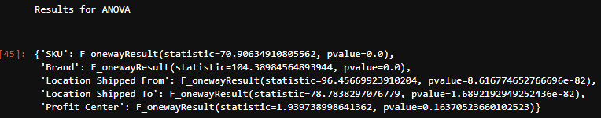
Appendix 2: Significance Tests for Categorical Variables
Perform ANOVA to test whether the mean sales value across each level of categorical variables differs
H₀: µ₀ = µ₁ = … = µ_{k}
H₁: Atleast one µ_{i} ≠ µ_{j#}
Profit Center only variable with p-value > 0.05. Implies no statistically significant difference between mean sales in PC1 and PC2.

Slide 12
Appendix 3: SARIMA Models
Ensure models stationary be differences to remove trend and seasonality components
Confirmed with Augmented dickey fuller test
Fit basic SARIMA (1,1,1)x(1,1,1) models with appropriate seasonal differencing applied
Future work – Tune model parameters more to improve predictions

Slide 13
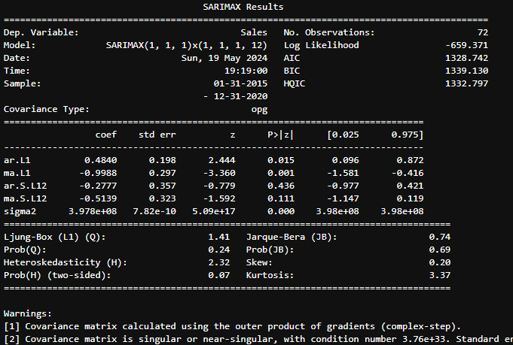
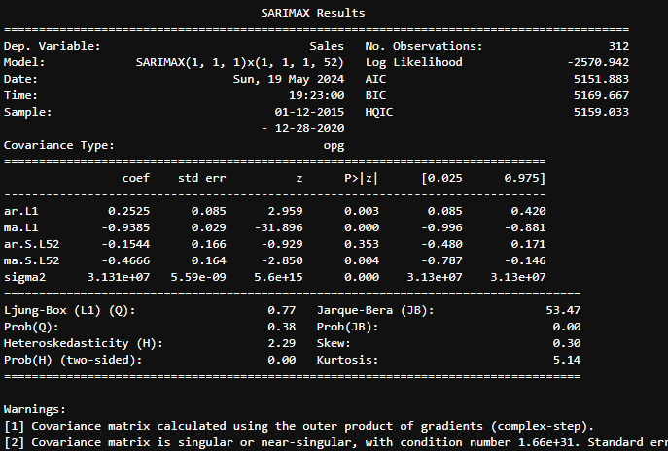
Monthly Model
Weekly Model

